Slide 1
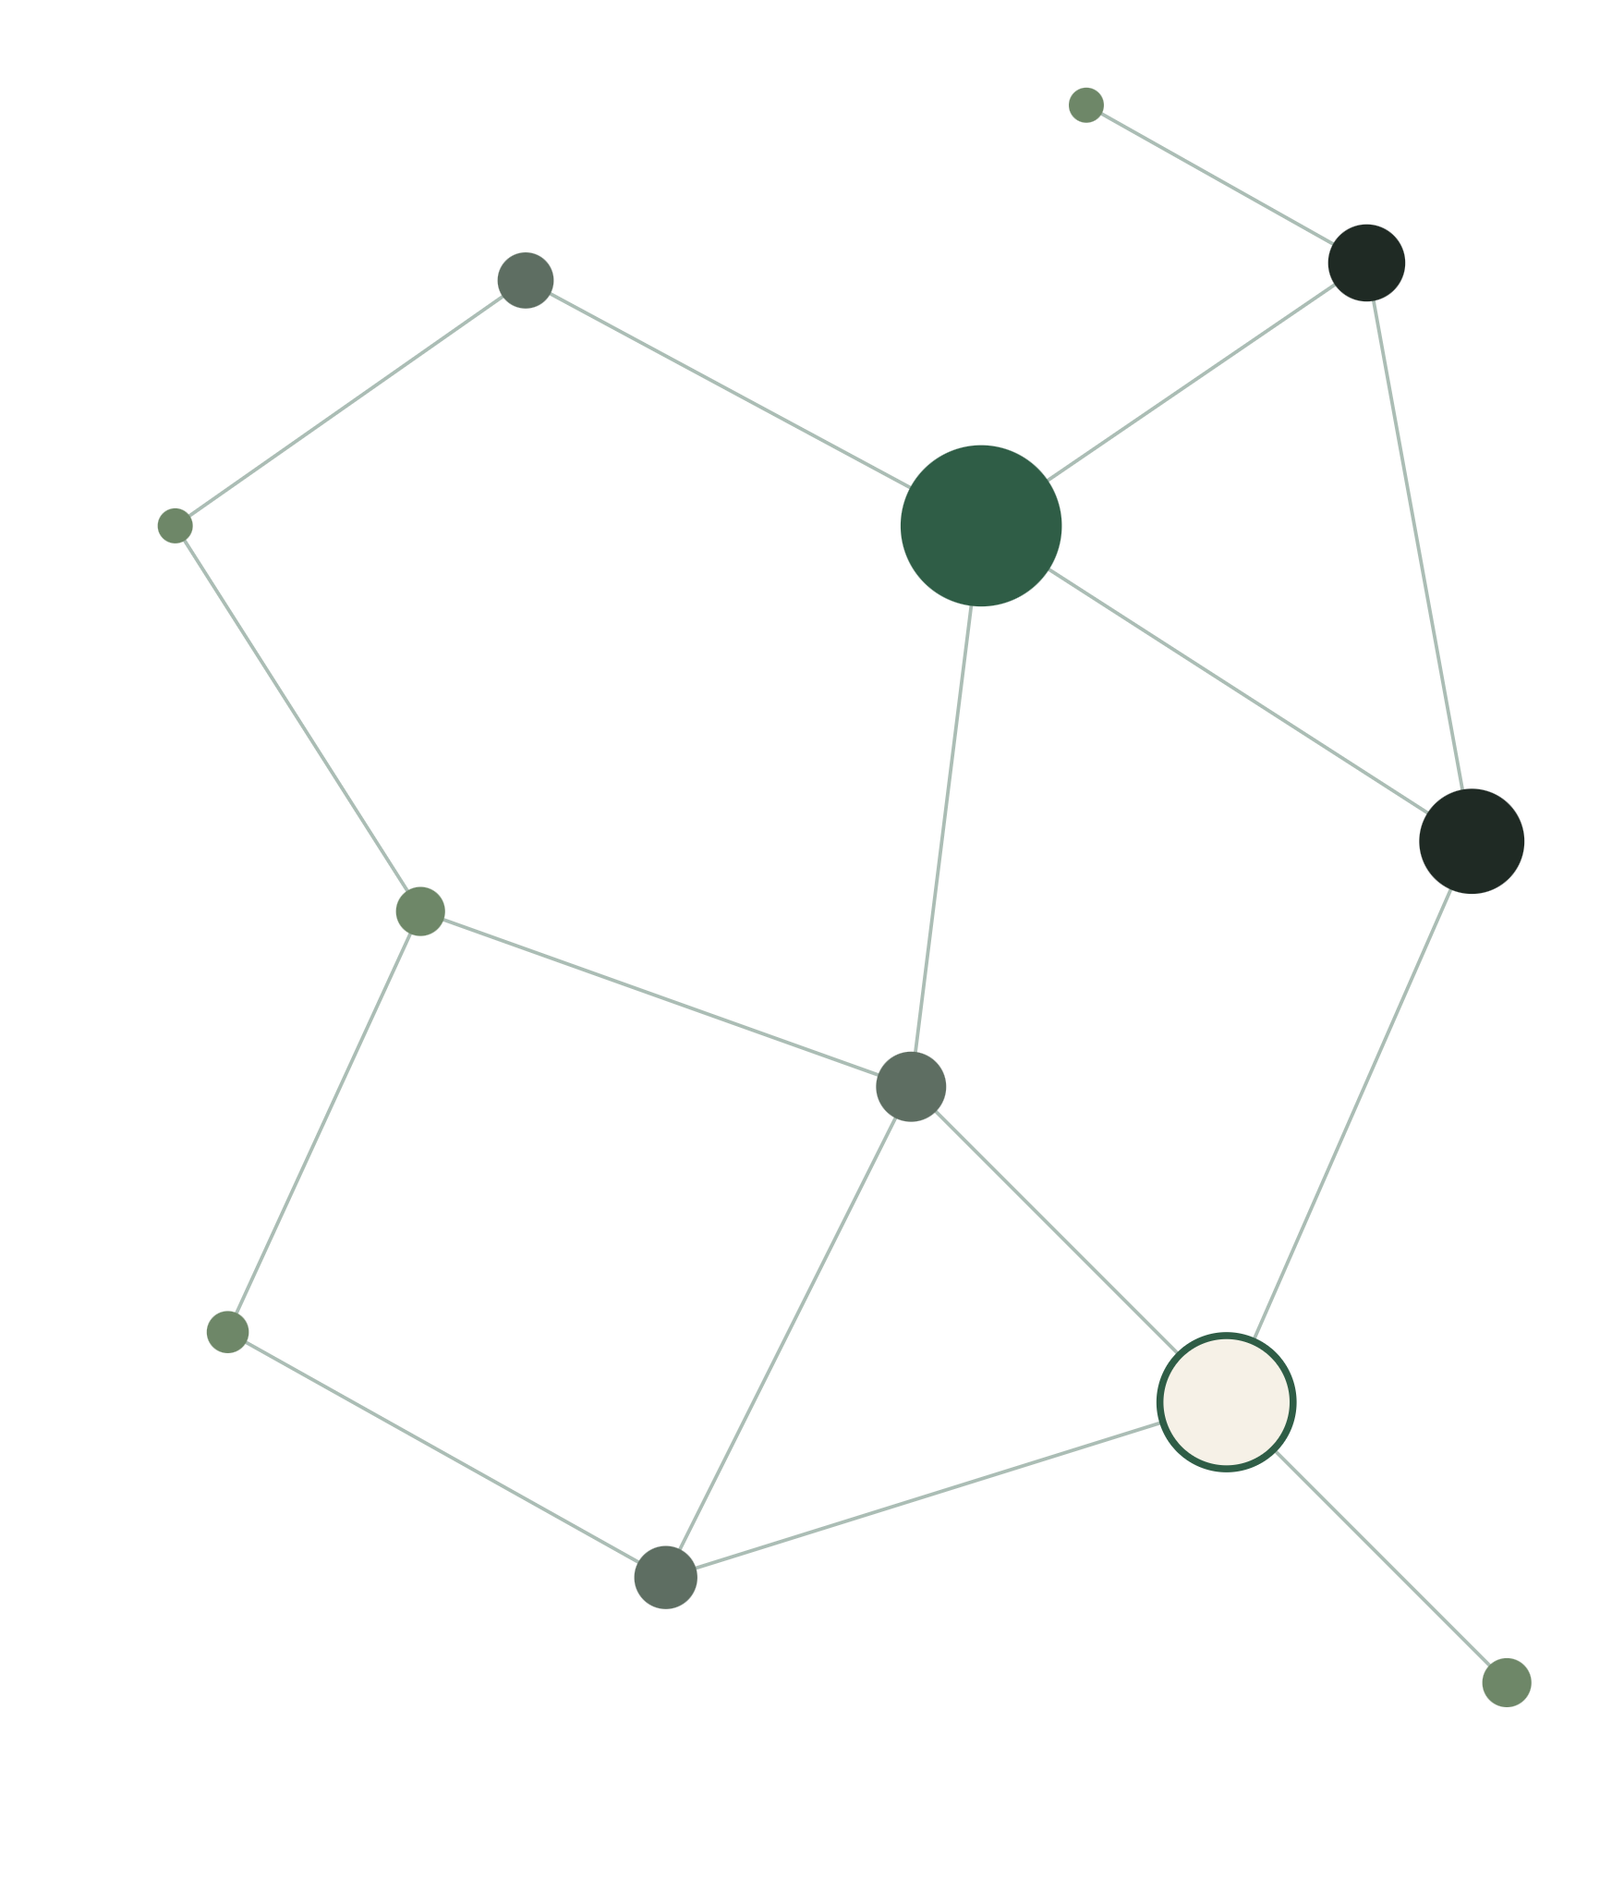
THE HIDDEN STRUCTURE OF WIKIPEDIA
Wikipedia Page Ranking Using PageRank
Analyzing the structural importance of Wikipedia pages through hyperlink networks.
[Anjana Soman, T. Vamshika] · [23BCB7103, 23BCB7123] · [CSE4039]
Notes:
Introduce the project: we rank Wikipedia pages using only the structure of their hyperlinks.

Slide 2
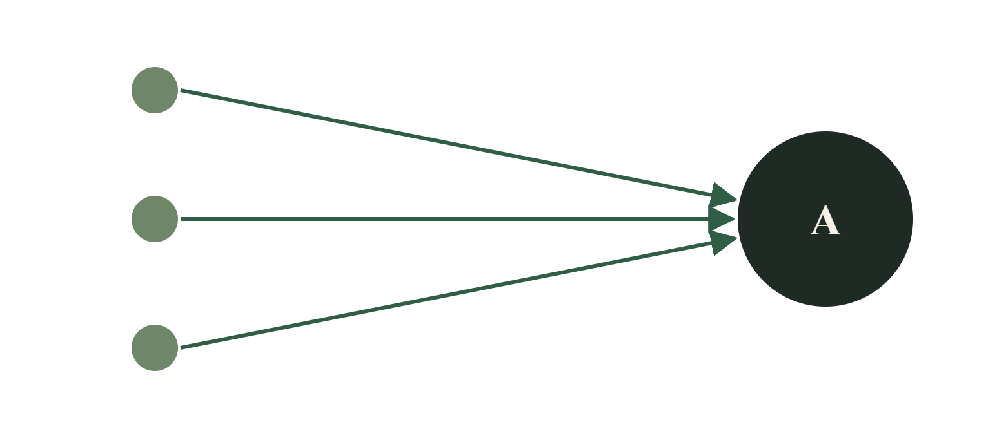
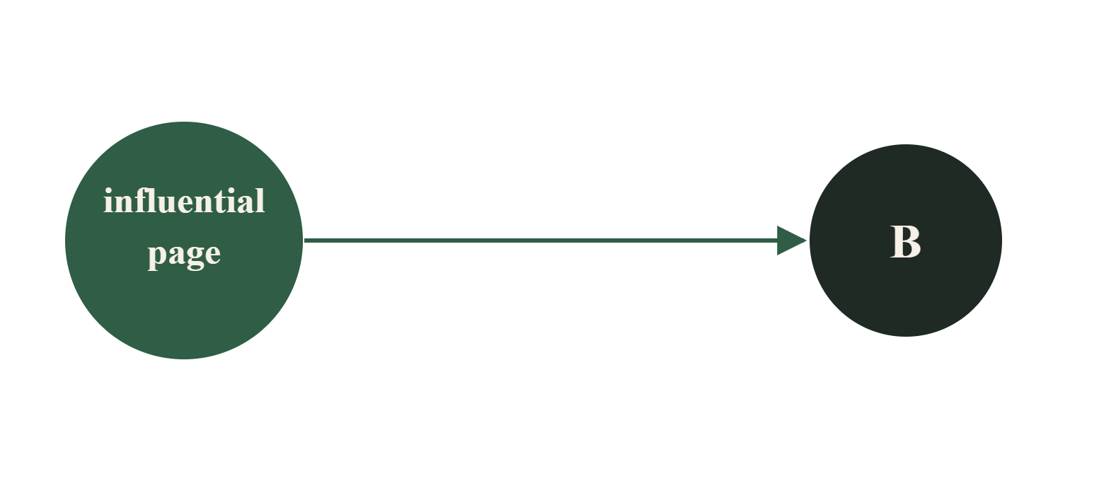
Not every link carries equal weight
COUNTING LINKS
WEIGHING LINKS
Page A: 3 links from obscure pages
Page B: 1 link from an influential page, which may matter more
How can we rank pages using the structure of the hyperlink network?
Wikipedia Page Ranking Using PageRank · 02 / 08
Notes:
Wikipedia pages link to each other, but a link from an important page should count for more than a link from an obscure one.

Slide 3
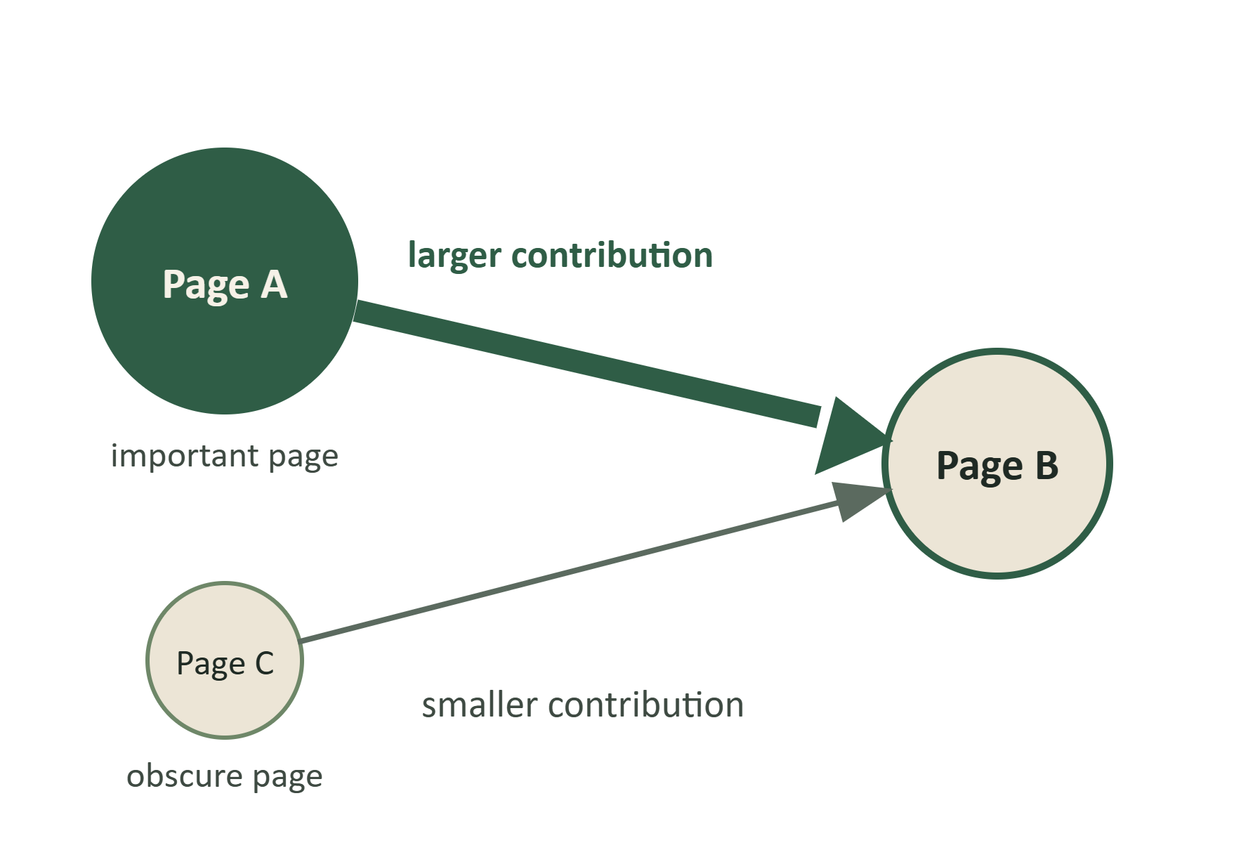
What Is PageRank?
DEFINITION
A link-based score that estimates a page's importance from its incoming links and the importance of the pages that link to it.
HOW IT WORKS
A link from an important page contributes more. Scores are updated repeatedly until they converge or the iteration limit is reached.
VERSUS IN-DEGREE
In-degree only counts incoming links. PageRank also weighs who is linking.
Wikipedia Page Ranking Using PageRank · 03 / 09
Notes:
PageRank scores a page by who links to it, not just how many links it has. Both A and C link to B, so in-degree counts two links; PageRank lets the link from the important page A contribute more. The algorithm updates scores repeatedly until they converge or the iteration limit is reached.

Slide 4
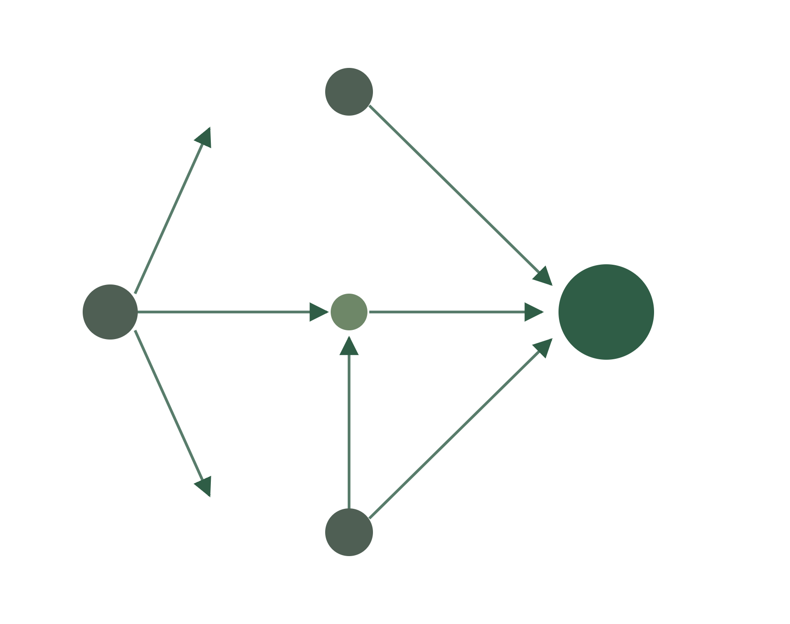
INPUT DATA
Wikipedia as a directed graph
Wikipedia Link Graph Dataset – 100K Pages (Kaggle)
100,000
8,577,044
pages (nodes)
directed edges
Page = node · hyperlink = directed edge. These are dataset statistics, not results.
Wikipedia Page Ranking Using PageRank · 04/ 08
Notes:
Input: 100,000 pages and 8,577,044 directed links from the Kaggle dataset. These numbers describe the data, not our output.

Slide 5
From link graph to ranking: Methodology
01
02
03
04
05
06
Dataset / prepared graph
Graph statistics and in-degree calculation
PageRank computation
Top page rankings
Comparison with in-degree ranking
Visual analysis
PageRank looks at the structure of links between pages, not merely how many links point to a page.
damping factor
tolerance
max iterations
0.85
1e-6
100
Wikipedia Page Ranking Using PageRank · 05/ 08
Notes:
Walk left to right through the six stages. Step 3 is where PageRank runs, using the parameters on the right.

Slide 6
Technologies used
LANGUAGE AND ANALYSIS
Python · Pandas · NumPy
Data handling and calculations
GRAPH PROCESSING
NetworkX
Working with the link graph
STATISTICS AND VISUALIZATION
SciPy · Matplotlib
Rank correlation and charts
INTERACTIVE DASHBOARD
Streamlit · Plotly
Exploring results in the browser
DEVELOPMENT ENVIRONMENT
Google Colab
Running and developing the project
Wikipedia Page Ranking Using PageRank · 06/ 08
Notes:
Each group has a purpose in the workflow; together they support the pipeline from graph to dashboard.

Slide 7
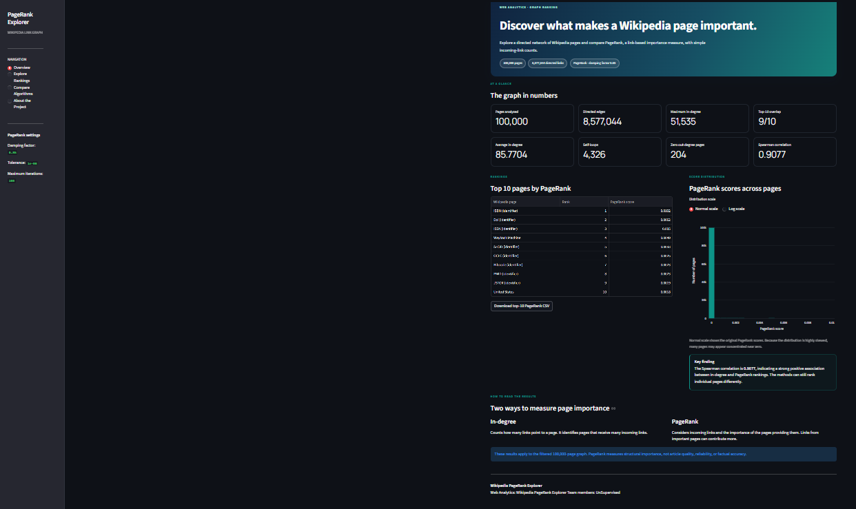
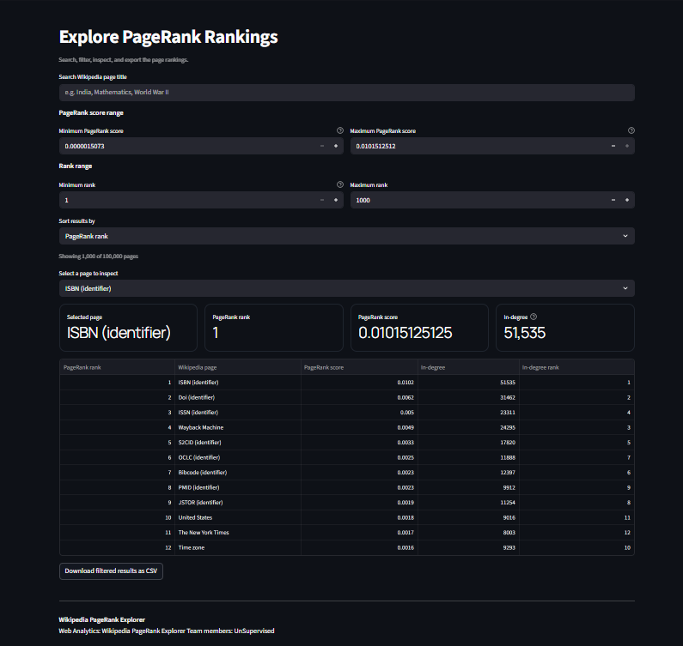
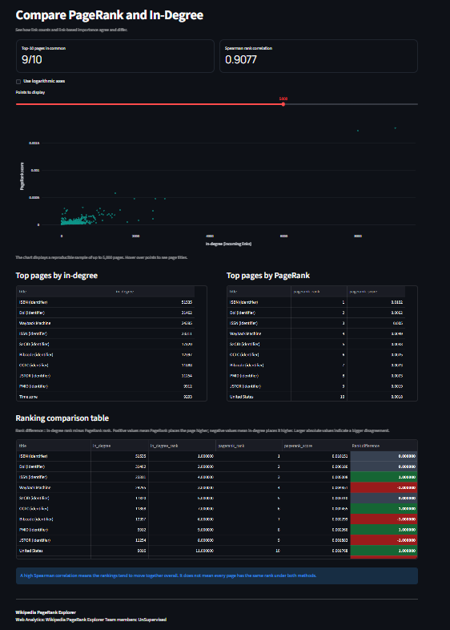
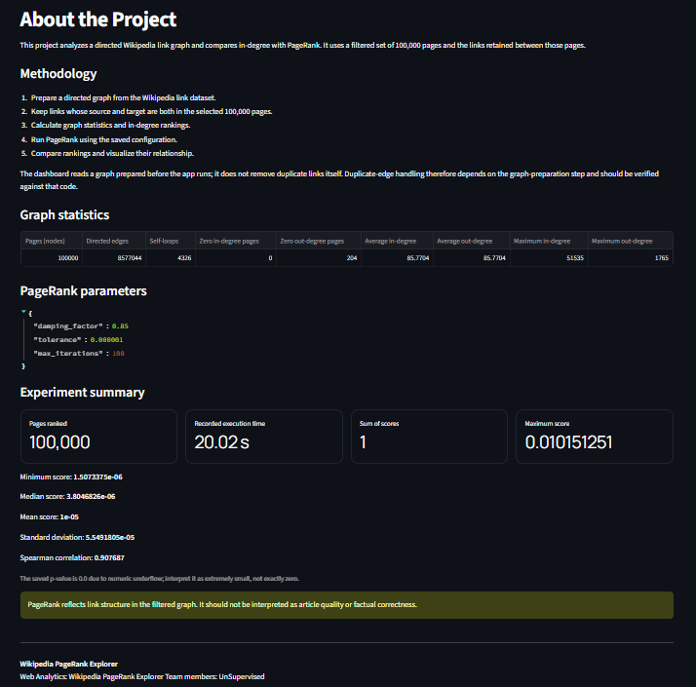
Overview
Explore Rankings
Interactive Streamlit Dashboard
Overview · Explore Rankings · Compare Algorithms · About the Project
Compare Algorithms
About the Project
Search pages by title
Inspect rank, score and in-degree
Compare PageRank with in-degree
Download filtered ranking data as CSV
Wikipedia Page Ranking Using PageRank · 07 / 08
Notes:
These are screenshots of our actual dashboard. It presents the computed rankings and lets viewers search, filter, compare and download.

Slide 8
Strong agreement, not identical
100,000
8,577,044
pages ranked
directed edges in the graph
9 / 10
0.9077
top-10 pages shared by in-degree and PageRank
Spearman rank correlation (approx.)
The two rankings move together strongly, yet link structure can still change the order of page importance.
Wikipedia Page Ranking Using PageRank · 08/ 08
Notes:
Key results from our run. A correlation near 0.91 means strong agreement, but the rankings are not the same.

Slide 9
Conclusion
1
2
3
Represented Wikipedia hyperlinks as a directed graph.
Used PageRank to estimate structural importance and compared it with in-degree ranking.
Built an interactive dashboard to explore and interpret the results.
Wikipedia Page Ranking Using PageRank
Notes:
Recap the three points, then invite questions.

